Slide 1
Expenzo
Team Members
Pratik Chittroda - 230081015
Ayush Jagani - 230081023
Priyank Hanspara - 230081022

Slide 2


Market Challenge & Our Solution
Problems :
• Users struggle with expense tracking
• No unified personal + business finance solution
Our Solution:
• Dual-mode system (Personal + Business)
• Easy Expense tracking
Page
01

Slide 3


Technical Architecture
Frontend:
• React Native
• React Navigation v7 for seamless navigation
• React Native Paper for Material Design
Backend:
• Firebase Firestore (real-time database)
• Firebase Authentication (multi- provider)
• Firebase Storage for documents
• Advanced security rules
Development:
• AsyncStorage for offline data
• Expo CLI for deployment
Page
02

Slide 4


CORE FEATURES
Personal Finance Tracking:
• Smart transaction tracking with auto-categorization
• Budget management with alerts
• Goal tracking and progress monitoring
Business Finance Tracking :
•Team Management
• Company Expense Management
•Company Budgets track and management
Customization :
• 8 custom themes + dark/light modes
• Personalized categories
Page
03

Slide 5

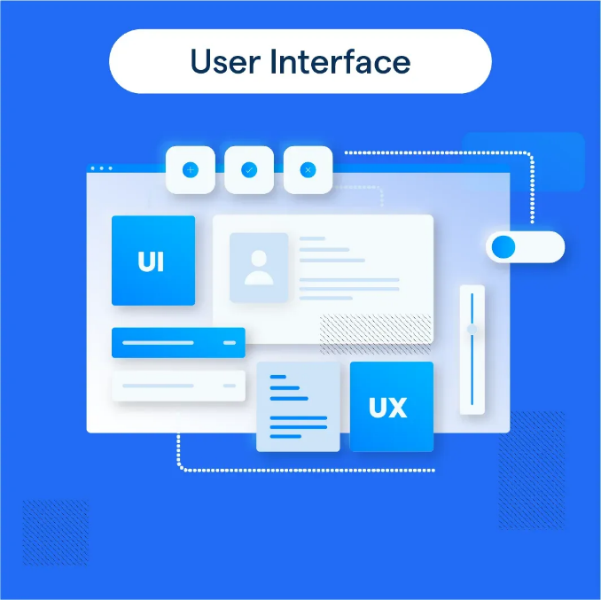
USER INTERFACE & EXPERIENCE
Key UI Features:
• Smooth animations and transitions
• Responsive design for all devices
• Accessibility compliance
• Consistent theming across all screens
Navigation:
• Tab-based navigation
• Stack navigation for detailed views
• Modal screens for quick actions
Page
04

Slide 6

DATABASE ARCHITECTURE
Firebase Collections:
• users/ - Profile, settings, preferences
• transactions/ - Financial data with categorization
• budgets/ - Limits, tracking, alerts
Features:
• Real-time synchronization
• Offline data caching
• Automatic backups
• Field-level security
Page
05

Slide 7
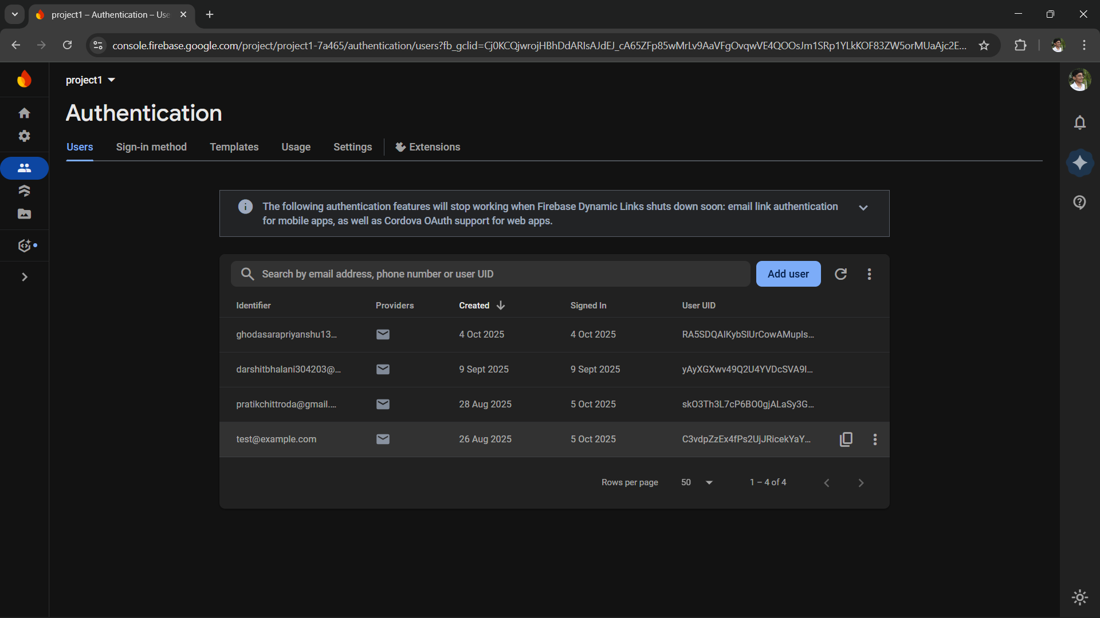
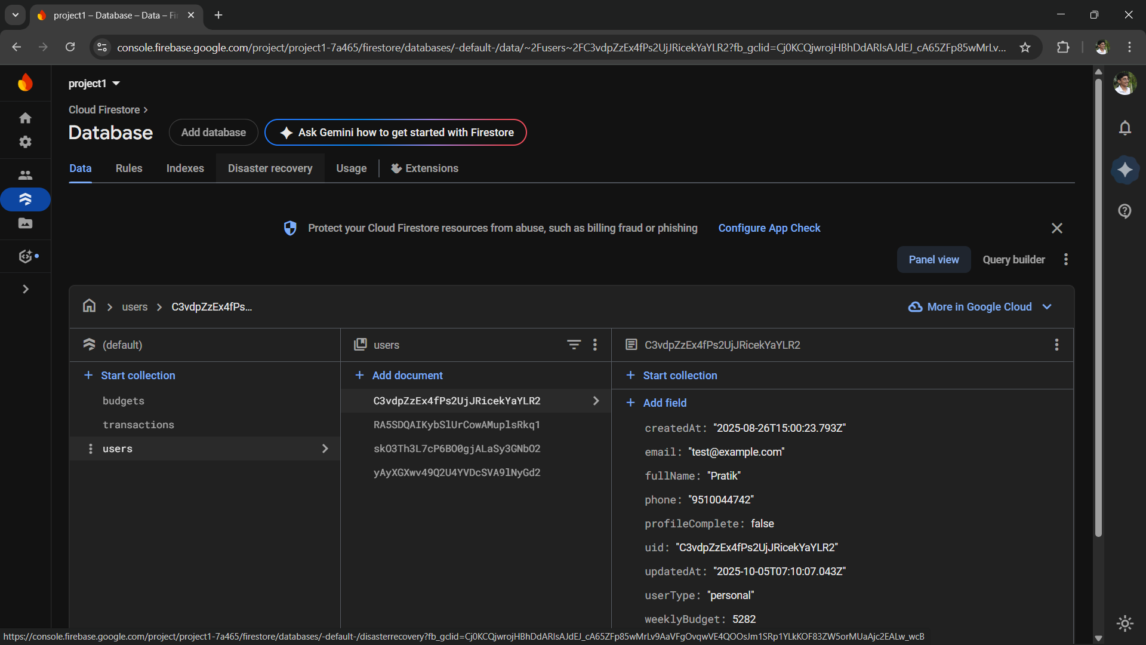
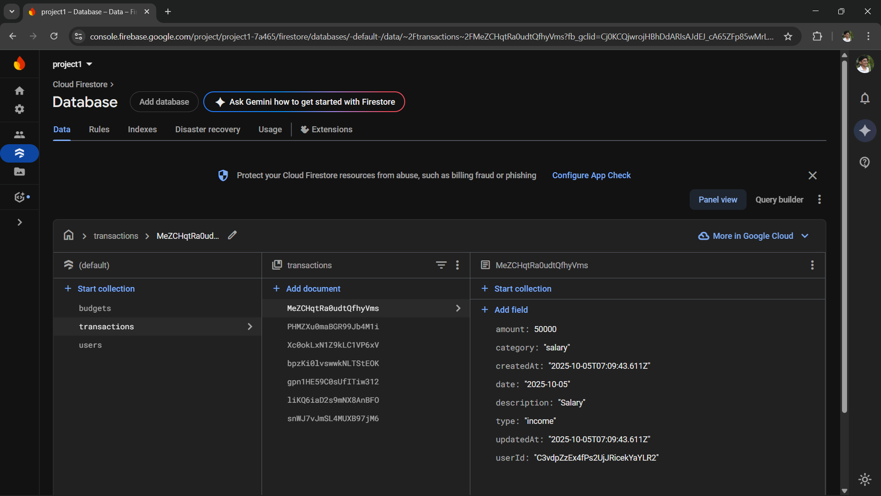
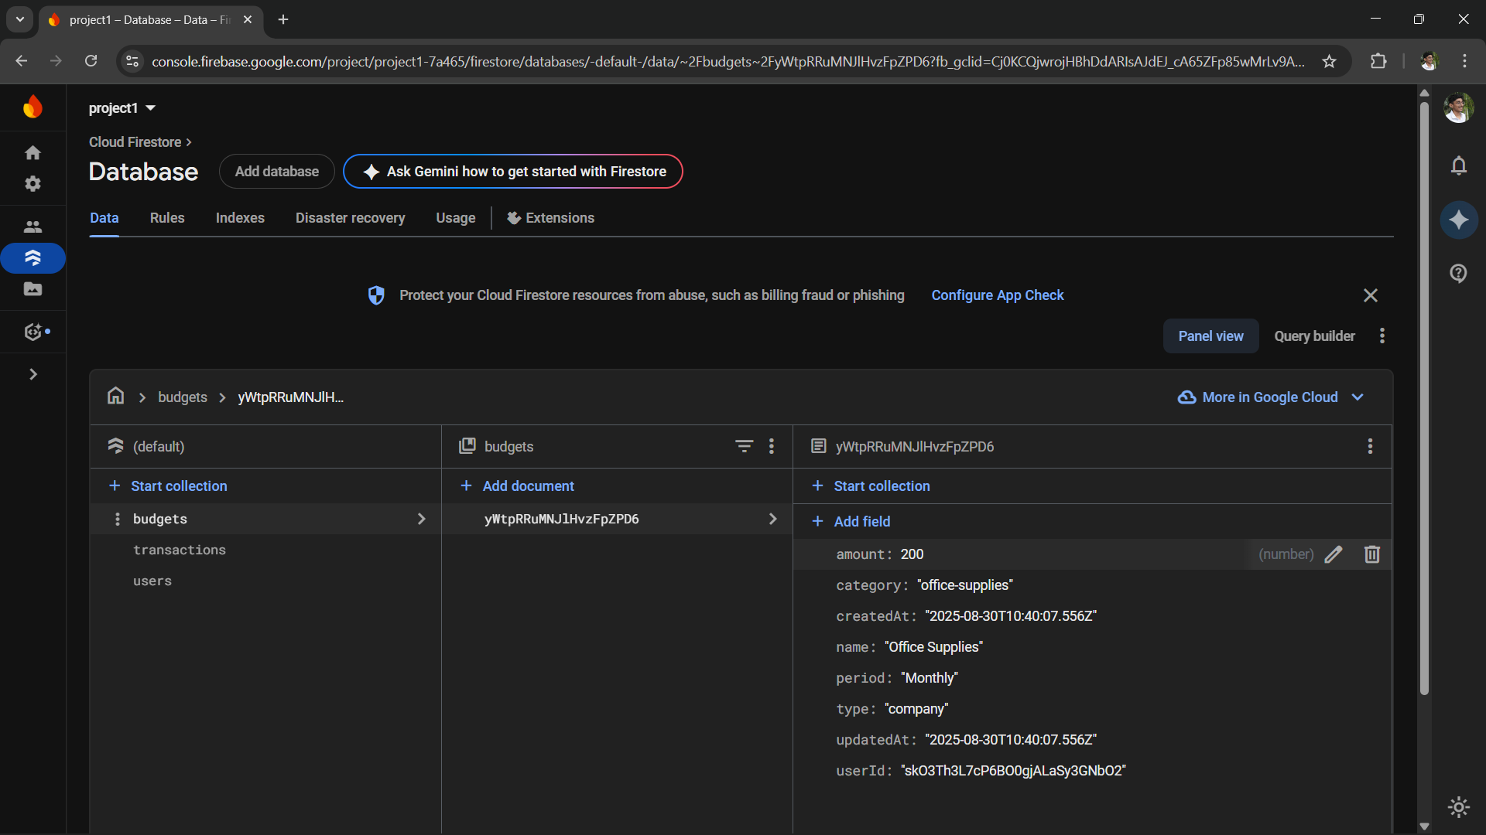
Page
05

Slide 8
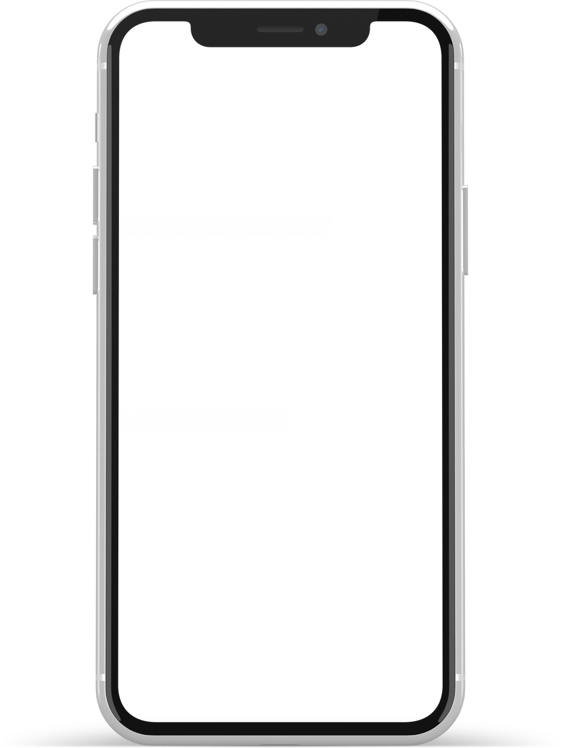
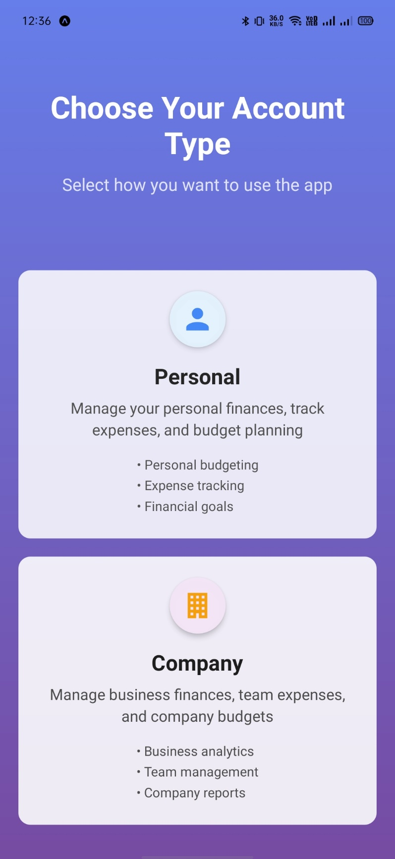
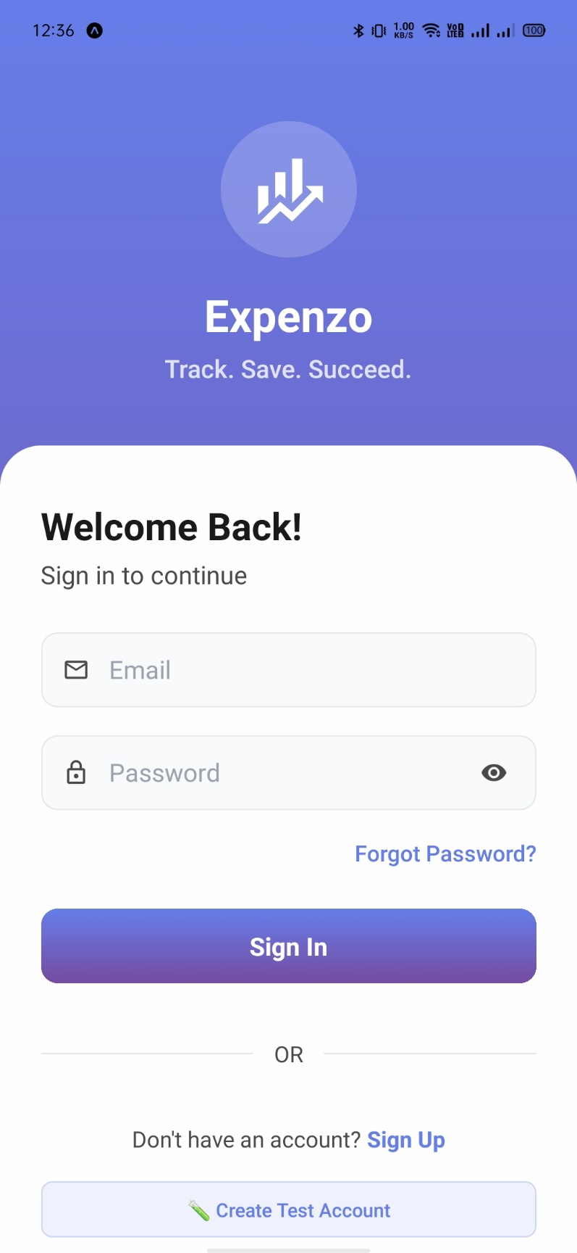
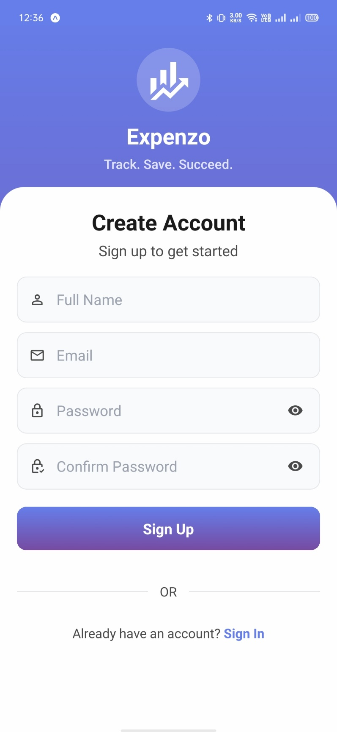
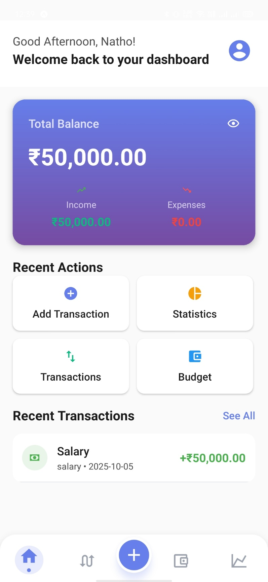
Screenshots
Page
07

Slide 9
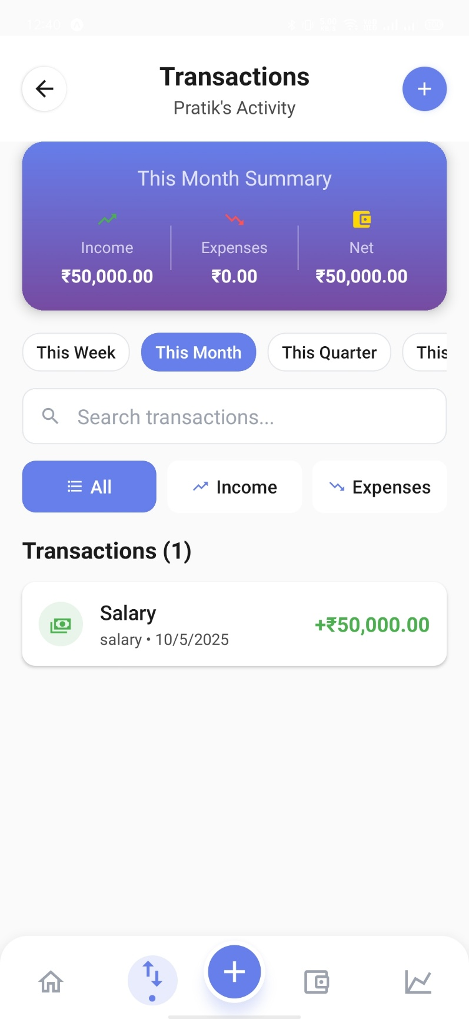
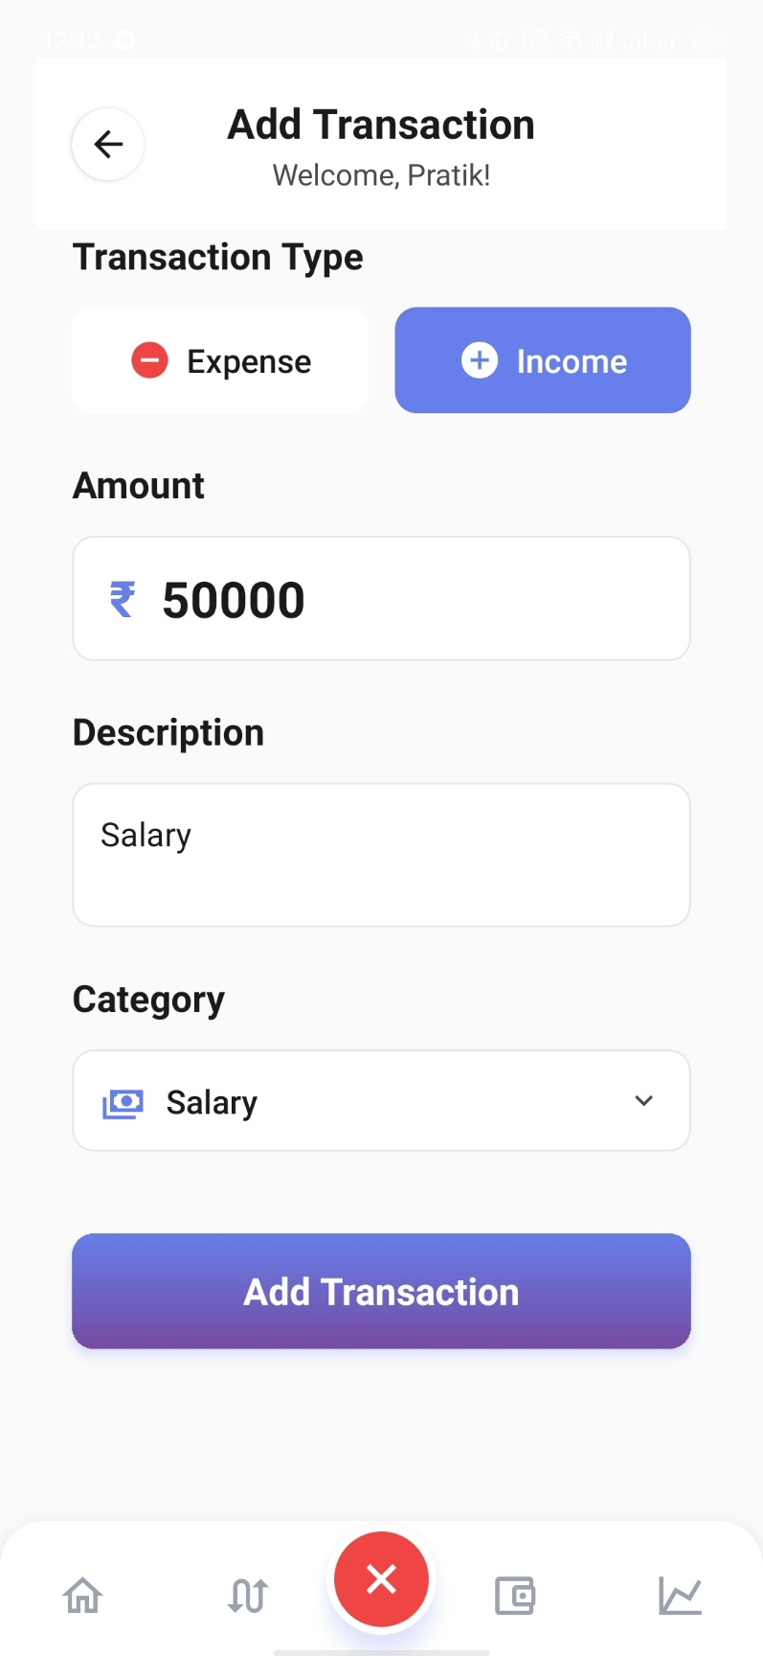
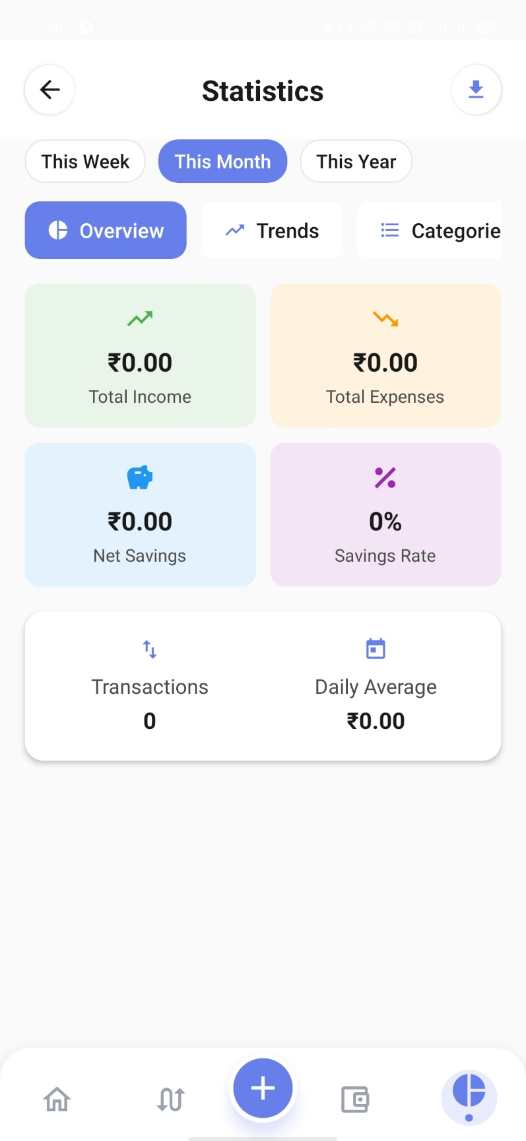
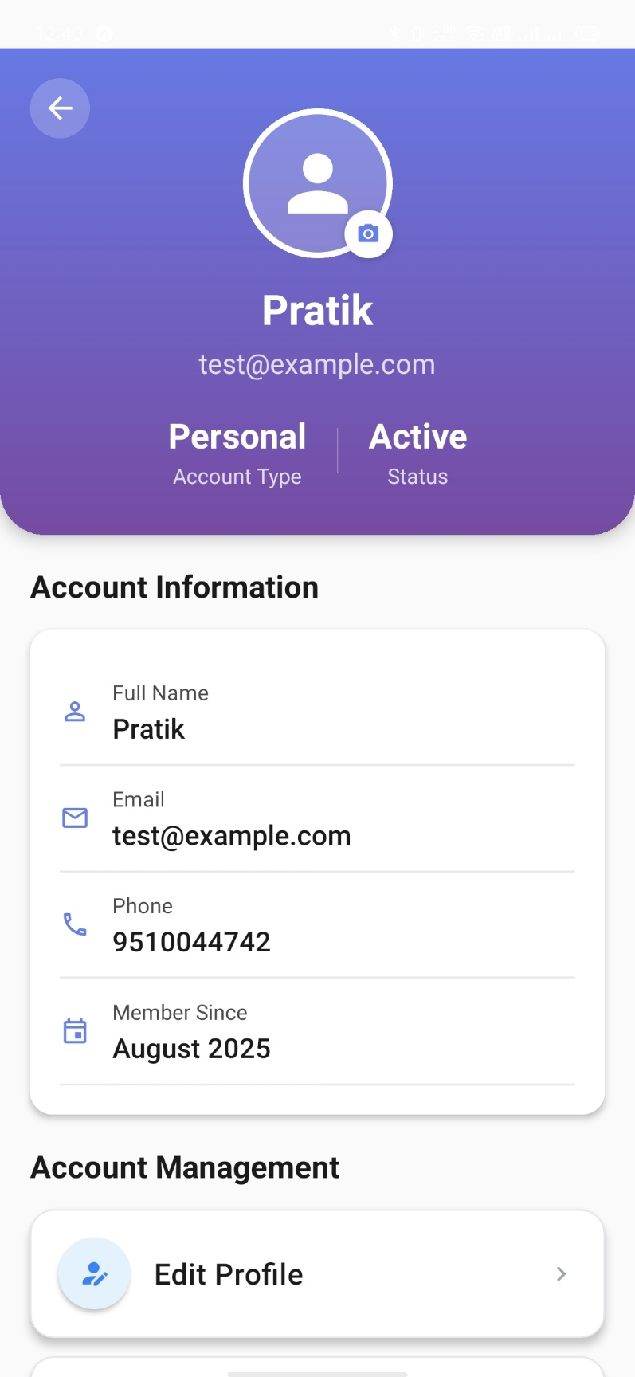
Screenshots
Page
08

Slide 10

Future Implementation Plan
Phase 1 :
• Advanced AI Implementation
• Investment tracking features
• Mobile receipt scanning
Phase 2 :
• Full AI financial assistant
• Advanced business analytics
• Multi-currency support
Phase 3 :
• Advanced investment planning
• Machine learning optimization
• Enterprise-grade integrations
Page
10

Slide 11
Thank
You.

